Slide 1
Technology of the Industrial Revolution
Chapter 11 Advertisement Project

Slide 2
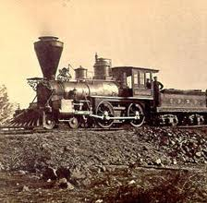
Step 1: Pick the Tech
Your options include, but are not limited to the following:
  Steam Engine
  Steam Boat
  Barbed Wire
  Railroad
  Photography
  Telegraph
If you want to choose a technology not listed here please see me to get it approved.

Slide 3
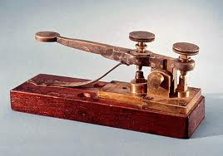
Step 2: Research the Tech
Spend a good amount of time researching the technology you choose.
  Use books and good internet sites (.edu, .org if possible)
  Find out dates, inventors names, important places
  Find and print out good, appropriate pictures of your advertisements

Slide 4

Step 2: Informative Paragraph
  Need at least a 5 sentence paragraph about the history of the tech
    Should be on the front of your advertisement
    Include names, dates, place and other facts
  Should be a brief history of the technology that convinces people to buy
  Answer the questions who, what, where, when and why

Slide 5
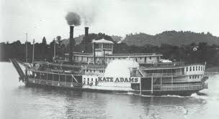
Step 3: Advertise the tech
Make an Advertisement Flyer for your technology
  Must include pictures (at least 2)
  Must include 1 catch phrase
    Must be a catchy phrase that will make people want to buy or use your technology
Industrial Revolution Advertisements were black and white
    NO COLOR PICTURES OR FONT

Slide 6

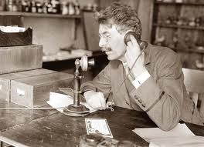
Step 3: Advertise the Tech
Advertisements are meant to make people want to buy or use the product
  Point out the positives of the technology
  Talk about how it will change the consumers life
  Add prices, coupons or store locations

Slide 7

Grading
30 Total Points
  5 points for pictures
  10 points for your paragraph
  5 points for neatness
  5 points for creativity
  5 points for working efficiently

Slide 8


Example Catch Phrases

Slide 9
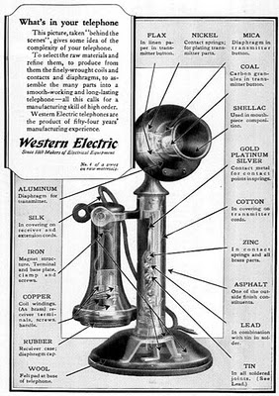

Slide 10
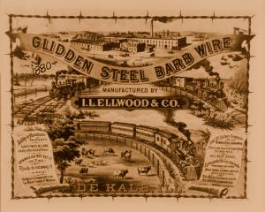

Slide 11


